Slide 1
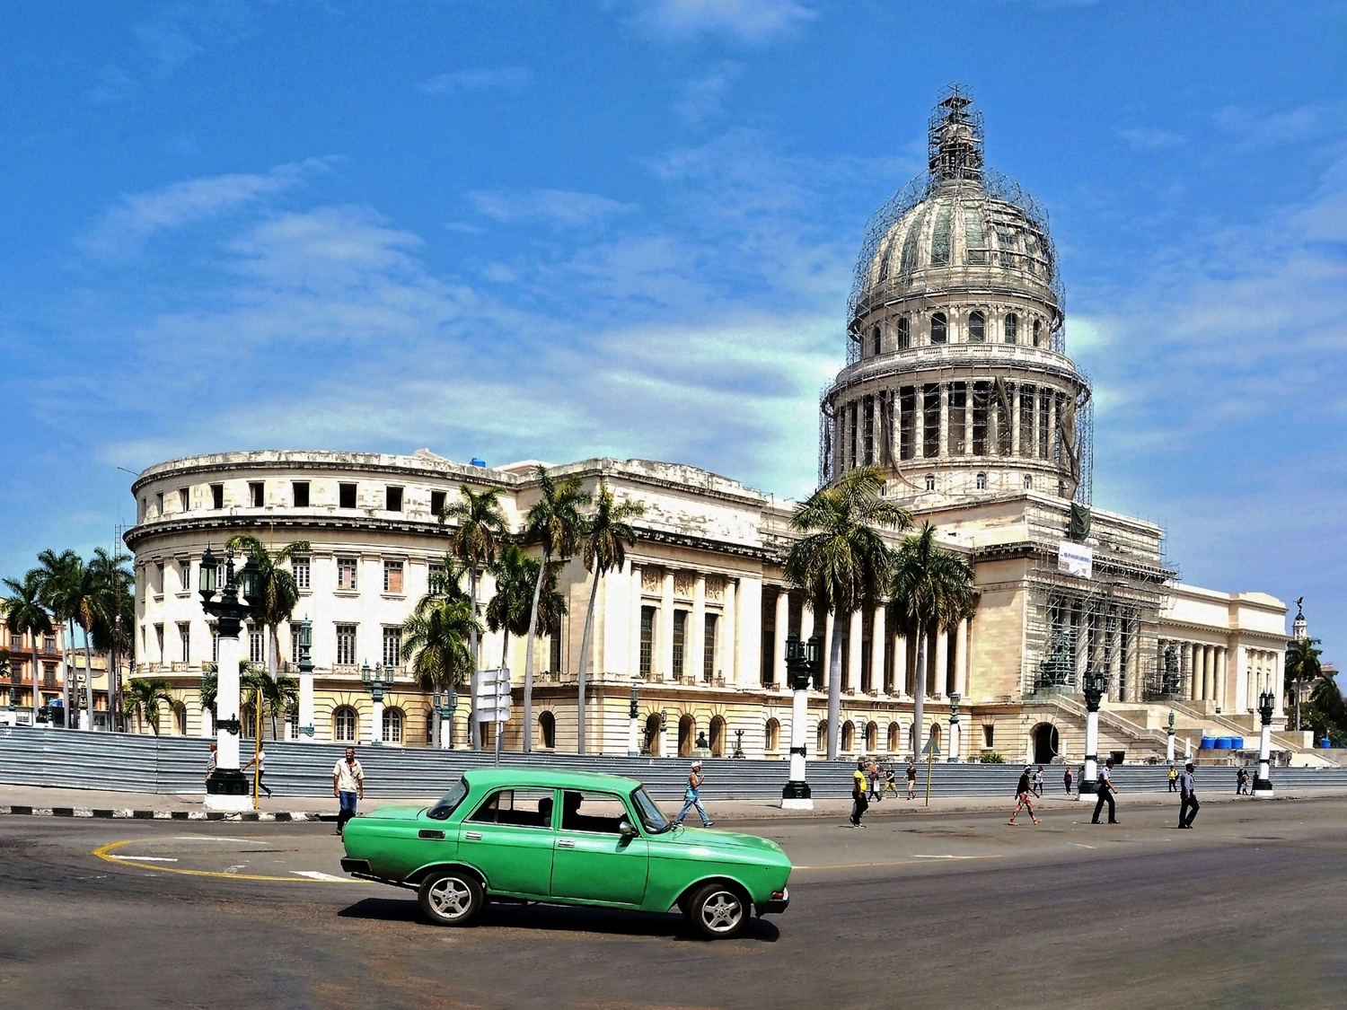
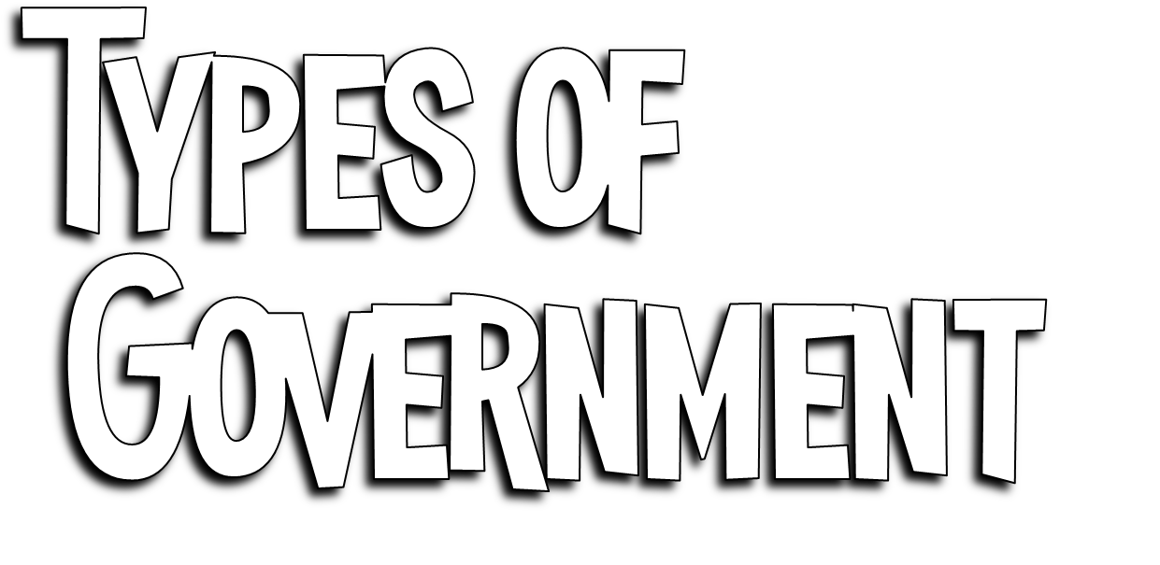

Slide 2
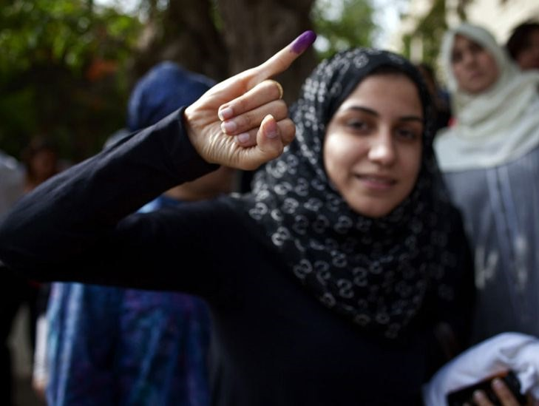
Autocracy
Oligarchy
Unitary government
Federal government
Confederation
Presidential government
Parliamentary government
Notes:
Autocracy is 1 person holding power. An Oligarchy is a form of power structure in which power rests with a small number of people.
A unitary state, or unitary government, is a governing system in which a single central government has total power over all of its other political subdivisions. A unitary state is the opposite of a federation, where governmental powers and responsibilities are divided.
A confederation (also known as a confederacy or league) is a union of sovereign groups or states, united for purposes of common action. i.e. European Union, Haudenosaunee / Iroquois league
Picture: A young voter shows with pride proof she took part in Egypt's first widely contested presidential election, May 23, 2012.

Slide 3
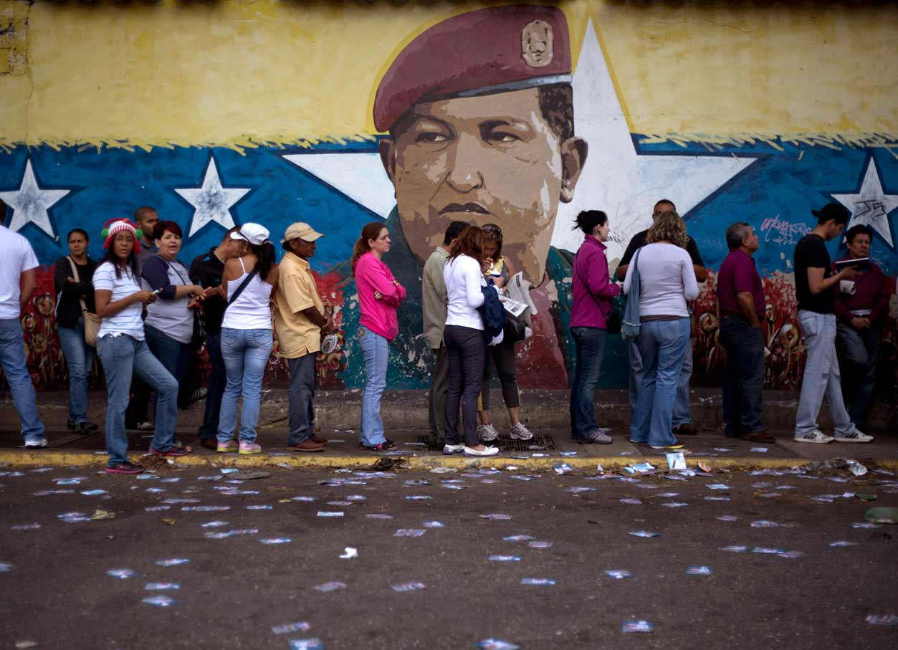
Participation
Who can participate in government and holds power?
Geographic
The geographic distribution of governing process
Legislative v. Executive
The relationship between the legislative (lawmaking) and the executive (law-executing) branches of government
Notes:
All government can be classified according to one or more of their basic features. Over time, political scientist have developed many bases upon which to classify governments. These include: Who can participate in the government process; the geographic distribution of governmental power within the state; and the relationship between the legislative and the executive branches of the government.
Picture: Venezuela polling station

Slide 4
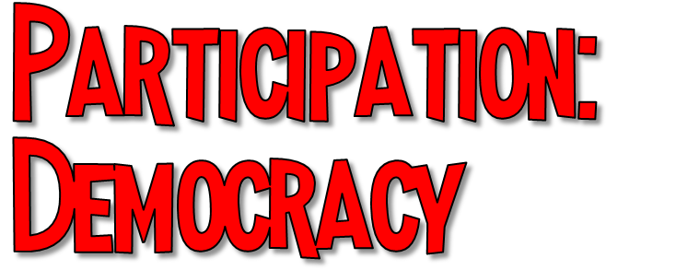
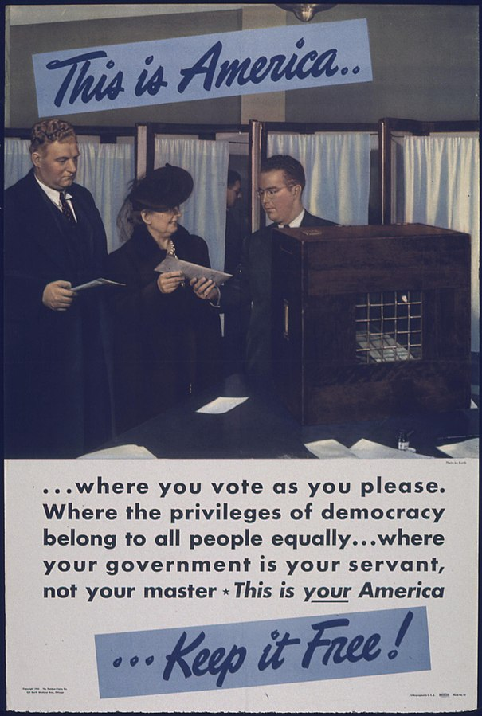
Political authority rests with the people
Government is conducted only by consent of the people

Slide 5
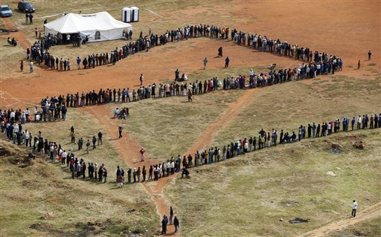
Direct Democracy-
“pure democracy”
Will of people made public law by the people themselves in mass meetings
Only really works for small communities
Indirect Democracy-
“representative democracy”
Small group chosen by people act as representatives to express the popular will
Notes:
Picture: A long line of people snake toward a polling station in the black township of Soweto outside of Johannesburg in South Africa’s first all-race election on April 27, 1994.

Slide 6
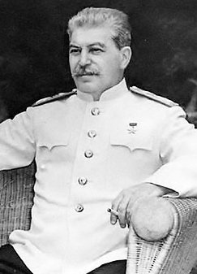
Absolute and unchallengeable authority over people
Rulers hold no responsibility to the will of the people

Slide 7
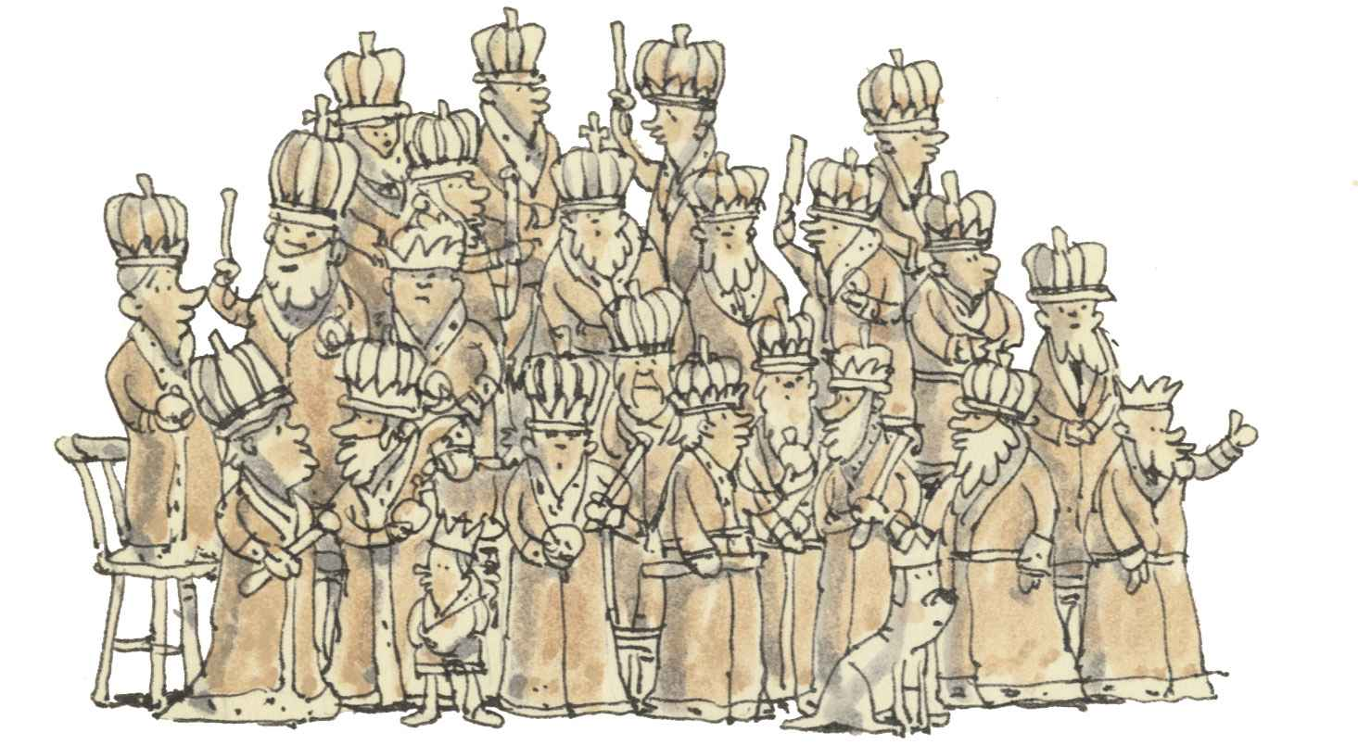
Autocracy:
Government in which a single person holds unlimited political power
Oligarchy:
Government in which the power to rule is held by a small usually self-appointed elite

Slide 8
Unitary Government
“centralized government”
All powers held by a central agency
Central gov’t creates local units
Federal Government
Power divided between central government and local governments
Central and local government have to agree to make changes

Slide 9
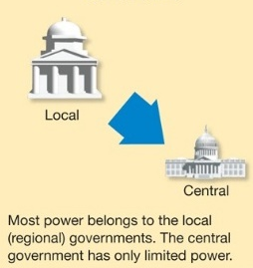
Confederation
Alliance of independent states
Central organization only handles those matters that member states assign to it
Usually limited to defense and tr

Slide 10
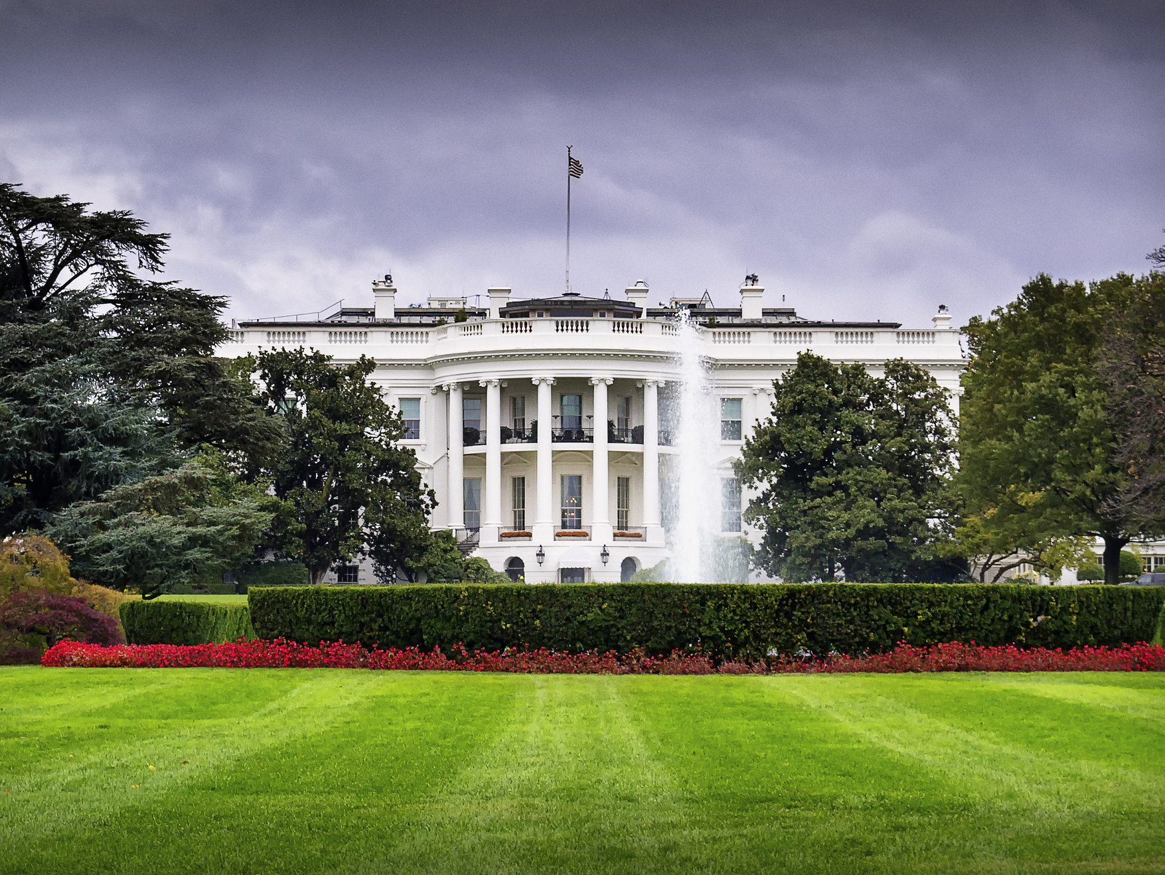
Executive and legislative are separate and independent
Chief executive (president) chosen independent of legislature
President holds office for fixed term
Broad powers not subject to control by legislative branch

Slide 11
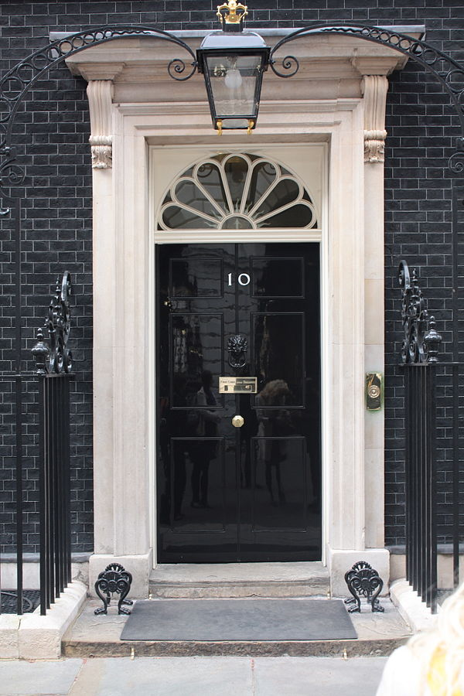
Executive is made up of Prime Minister or premier and official cabinet
Prime Minister is member of legislative branch
Prime Minister is member of majority party of Parliament
Subject to direct control
Notes:
Picture: Door of 10 Downing Street in London, home of the British Prime Minister

